Slide 1
Cost Estimation Techniques
APSC 221 – Week 1
Summer 2024

Slide 2
We are engineers, not accountants.

Slide 3
Cost and Revenue Structure
Categories of Costs and Revenues used in an engineering economic study:
Capital Investments
Labour Costs
Material Costs
Maintenance Costs
Taxes & Insurance
Overhead Costs
Disposal & Salvage Costs
Revenues
Where would we find this data?
Internal sources
Accounting/Finance
Institutional memory
External Sources
R&D programs
Internet

Slide 4
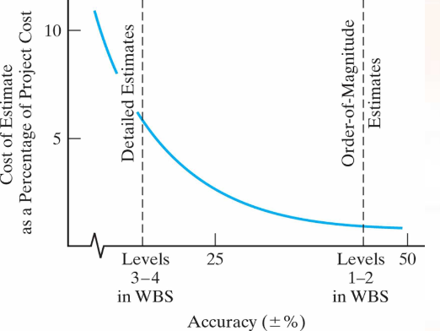
Cost and Revenue Estimates
Estimates classified based on detail, accuracy, and intended usage
Order of Magnitude Estimate
Semi-detailed/Budgetary Estimate
Definitive/Detailed Estimate

Slide 5
Estimation Techniques
Order of Magnitude & Budgetary Level Accuracy:
Indexes
Unit Technique
Parametric Cost Estimation
Power-sizing
Learning Model

Slide 6

Indexes
Indexes are dimensionless values used to estimate relationships of the past or future relative to a defined reference point.
Help quantify relativistic variables
Changes in technology or economies of scale
Scarcity or abundance of resources
$$C_{n}=C_{k}\left(\frac{I_{n}}{I_{k}}\right)$$
Where:
$k$ is the reference year
$n$ is the target year
$C$ is the cost; and
$I$ is the index value
Consumer Price Index (CPI)

Slide 7

Unit Techniques
When you have known, and reliable, average per unit costs / revenues, allows scalability
ie. Quoting to roof a larger home vs a smaller home
Or
When you know the relative per unit costs / revenues
ie. Digging a trench through soil vs clay vs bedrock

Slide 8
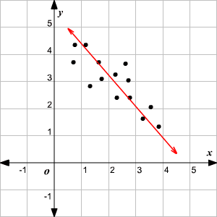
Parametric Cost Estimating
Based on historical data and statistical methods to develop a model
ie. Line of best fit
Models focus on key independent variables or cost drivers to model budget level costs

Slide 9
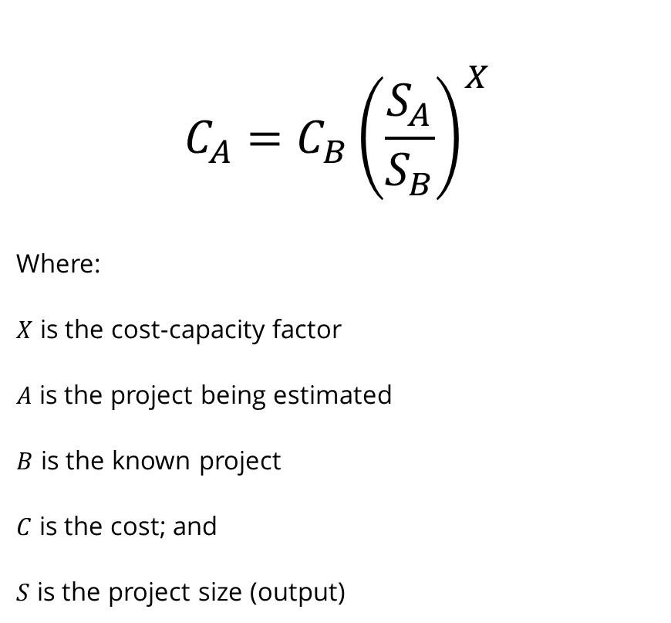
Power-Sizing Technique
Modeling that considers economies of scale
Recall definitions of fixed and variable costs
$$C_{A}=C_{B}{\left(\frac{S_{A}}{S_{B}}\right)}^{X}$$
Where:
$X$ is the cost-capacity factor
$A$ is the project being estimated
$B$ is the known project
$C$ is the cost; and
$S$ is the project size (output)
Doubling the production does not double the total project cost!

Slide 10
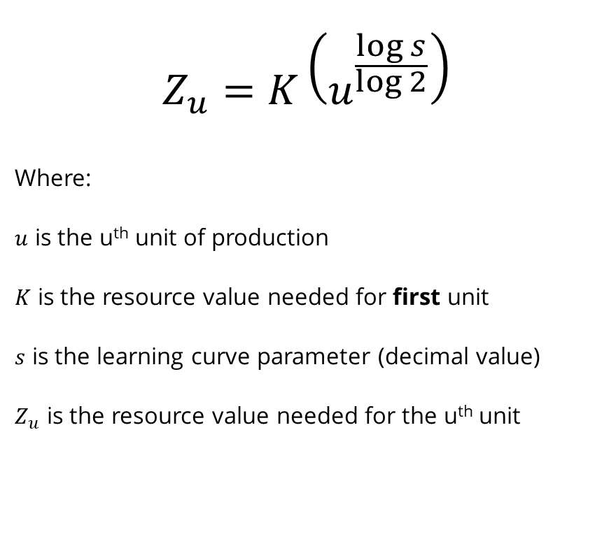
Learning Curve Model
Modeling based on assumption that there is a constant percentage reduction in input resources as the outputs double
$$Z_{u}=K\left(u^{\frac{\log{s}}{\log{2}}}\right)$$
Where:
$u$ is the u^{th} unit of production
$K$ is the resource value needed for first unit
$s$ is the learning curve parameter (decimal value)
$Z_{u}$ is the resource value needed for the u^{th} unit
Intuitive logic that says the more you do something, the faster you should get at doing it.

Slide 11
Logic and reasoning MUST prevail when doing estimates.

Slide 12
Examples
QSET (Queen’s Space Engineering Team) is building microsatellites to go on the next SpaceX launch. The team needed 50 hours to assemble the first satellite. Their improvement (or learning rate) is 0.7, meaning as output doubles, their time to assemble a satellite is reduced by 30%. What is the cost of the 20th microsatellite?
The CPI factor in Canada for June 2022 was 8.1%. You are given the budget from a near-identical project from the year previous, where it cost them $25,000. What would your budget amount be?
How would you go about solving these problems?

